Slide 1
A simple Address Book
RoboSharks (Team 3)

Slide 2


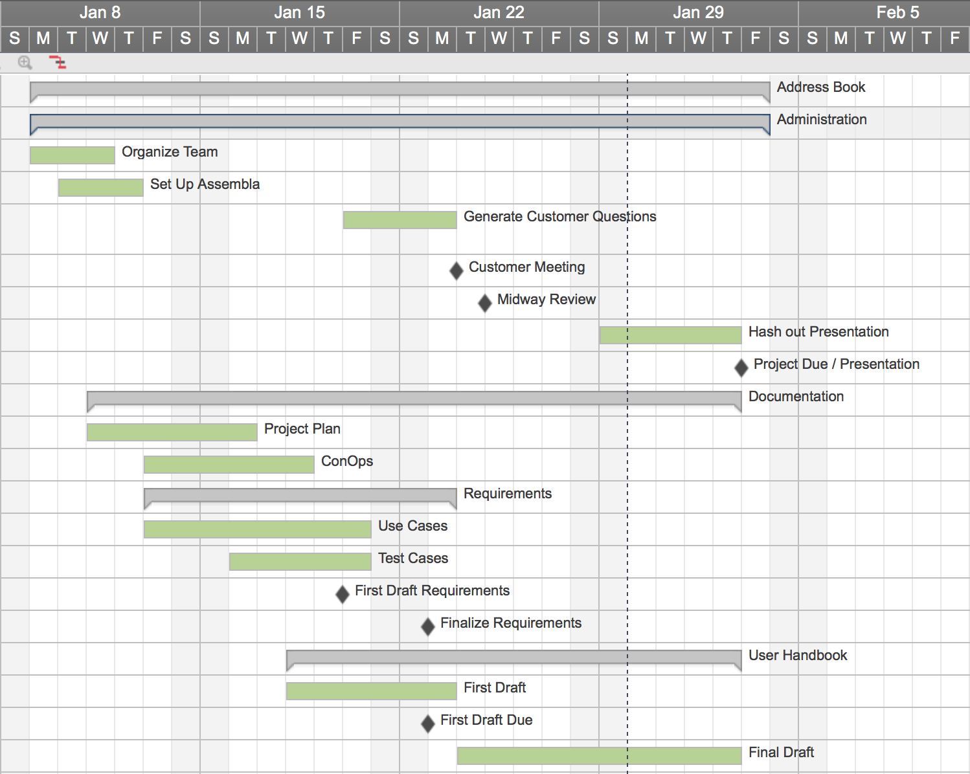
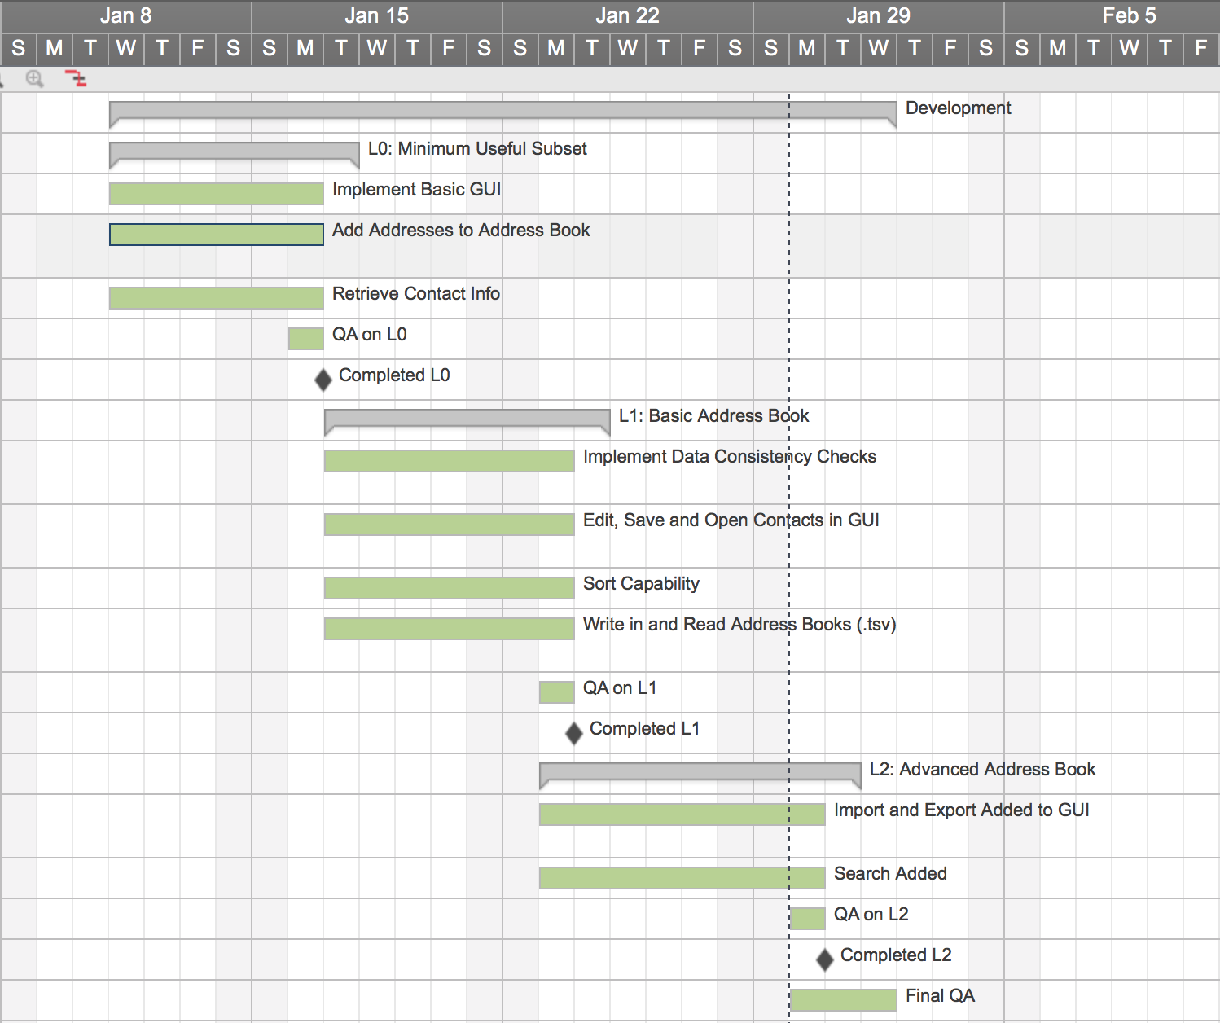
Project Plan

Slide 3
Planning – Expected Deliverables
A Clearly Documented Project:
Project Plan
Schedule Includes All Milestones and Deliverables
To Do List and Meeting Notes
Software Requirements
Use Cases
Quality Requirements
Software Design
Software Architecture
Module Interface Specifications
An Address Book that Achieves:
All Expected Requirements
L1: Minimum Useful Subset
L2: Basic Address Book
L3: Advanced Address Book
Fast, Reliable, Consistent
Additional Customer Requirements
Search by Any Field
Mechanisms to Protect Address Book Data
Surprise Bonus Feature

Slide 4
Planning – ACHIEVED Deliverables
A Clearly Documented Project:
Project Plan
Schedule Includes All Milestones and Deliverables
To Do List and Meeting Notes
Software Requirements
Use Cases
Quality Requirements
Software Design
Software Architecture
Module Interface Specifications
An Address Book that Achieves:
All Expected Requirements
L1: Minimum Useful Subset
L2: Basic Address Book
L3: Advanced Address Book
Fast, Reliable, Consistent
Additional Customer Requirements
All Inclusive Search
Mechanisms to Protect Address Book Data
Surprise Bonus Feature

Slide 5
An Address Book That Works.

Slide 6

A Satisfied Customer
Address Book Application
Meets All Listed Requirements
Additional Customer Requirements Met
Product is Lightweight, Fast and Reliable
Maintained Deadlines
Produced on Time and at Budget

Slide 7

Lessons Learned
Project Planning
Rocky Start, Smooth Finish
Midway Review Turned It Around
Schedule Delays
Poor Planning in the Beginning
Snowball Effects
Risk Management
Adequately Defined
Helped Navigate Issues

Slide 8

NEXT TIME…
A Plan From the Beginning
Mark Important Milestones and Deadlines
Clearly Drawn Out Timelines
Pre-determined Software Design

